Slide 1


Mutual Fund Capstone Project
ETL • ANALYTICS • RISK METRICS • REPORTING

Slide 2





SUBMISSION STRUCTURE
Data Engineering
Exploratory Analysis
Performance Metrics
Final Storytelling
ETL pipeline, SQLite schema, and query readiness.
Trends, fund-house patterns, and category summaries.
CAGR, Volatility, Sharpe Ratio, Beta, and VaR analysis.
Interactive dashboard and executive presentation.

Slide 3

DELIVERABLES & WEIGHTAGE
Foundation (D1-D3)
Analytics (D4-D7)
D1 ETL Script (15%): End-to-end error handling.
D4 Metrics (15%): Precise risk formulas.
D2 SQLite DB (10%): Complete schema & tables.
D5 Dashboard (20%): Functional slicers.
D3 EDA Notebook (15%): Insightful charts and explanations.
D6/D7 Results (25%): Findings & reporting.

Slide 4





WORKFLOW PIPELINE
Extract
Transform
Load
Analyze
Raw scheme, NAV, and benchmark files.
Normalizing dates and standardizing fields.
Persist into SQLite for reproducible queries.
Derive performance and risk metrics.

Slide 5

DATABASE DESIGN (SQLITE)
Reference Tables
Analytical Tables
• Fund Master Metadata
• NAV History & Rolling Performance
• Benchmark Index History
• Investor Transactions & SIPs
• SIP & Industry Folio Counts
• Portfolio Holdings Composition

Slide 6
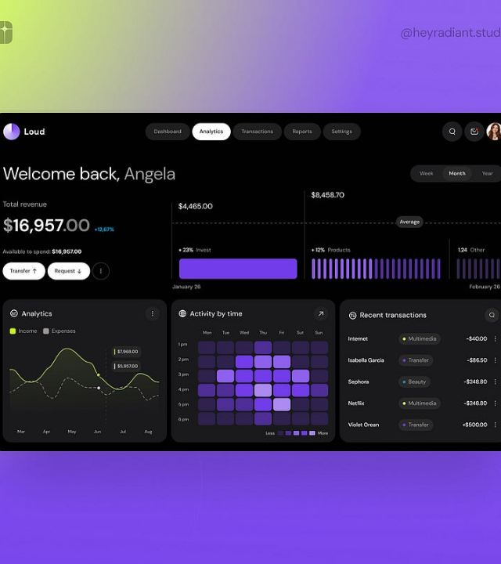
EXPLORATORY ANALYSIS
Flow Patterns: Reveal retail participation trends across categories.
Fund Concentration: Analyze AMC market dominance and AUM fragmentation.
Behavior Shifts: Track systematic investing and redemption pressure.

Slide 7
PERFORMANCE ANALYTICS
Return and Risk
Relative Performance
CAGR: Annualized growth over NAV period.
Sharpe Ratio: Excess return vs total risk.
Volatility: Standard deviation of periodic returns.
Beta: Benchmark movement sensitivity.
VaR: Downside loss at specific confidence.
Spread: Delta vs category benchmark.

Slide 8




DASHBOARD BLUEPRINT
Overview
Performance
Transactions
Risk
KPI Cards & AUM Summary.
Scheme vs Benchmark Comparison.
Purchase & SIP Behavior.
VaR & Holdings Concentration.

Slide 9






ADVANCED ANALYTICS
Cohort Analysis
Recommender
Stress Metrics
Analyze retention and repeat investor behavior.
Logic-based matching using volatility profiles.
Historical VaR distribution summaries.

Slide 10
EXECUTION PLAN
Stabilize ETL & DB: Ensure every table is queryable before notebooks.
Notebook Development: Use SQLite as the single source of truth for EDA.
Dashboard Finalization: Reuse validated metrics to ensure data consistency.

Slide 11
QUALITY CHECKLIST
Technical Excellence
Presentation Value
• Zero manual interventions in script.
• High-impact, readable visuals.
• Mathematical precision in formulas.
• Interactive slicers in Power BI.
• Complete, normalized database schema.
• Clear executive business summary.

Slide 12


Final Message
A strong capstone is not just about calculations. It showcases a reliable pipeline, a trustworthy database, and business-ready storytelling.

